Slide 1
CONTOSO COMPANY
PRODUCT RETURN ANALYSIS
Le Duc Nguyen - MDA K33

Slide 2
PROBLEM STATEMENT
WHAT IS THE PRODUCT TYPE THAT RETURNS FOCUS ON?

Slide 3
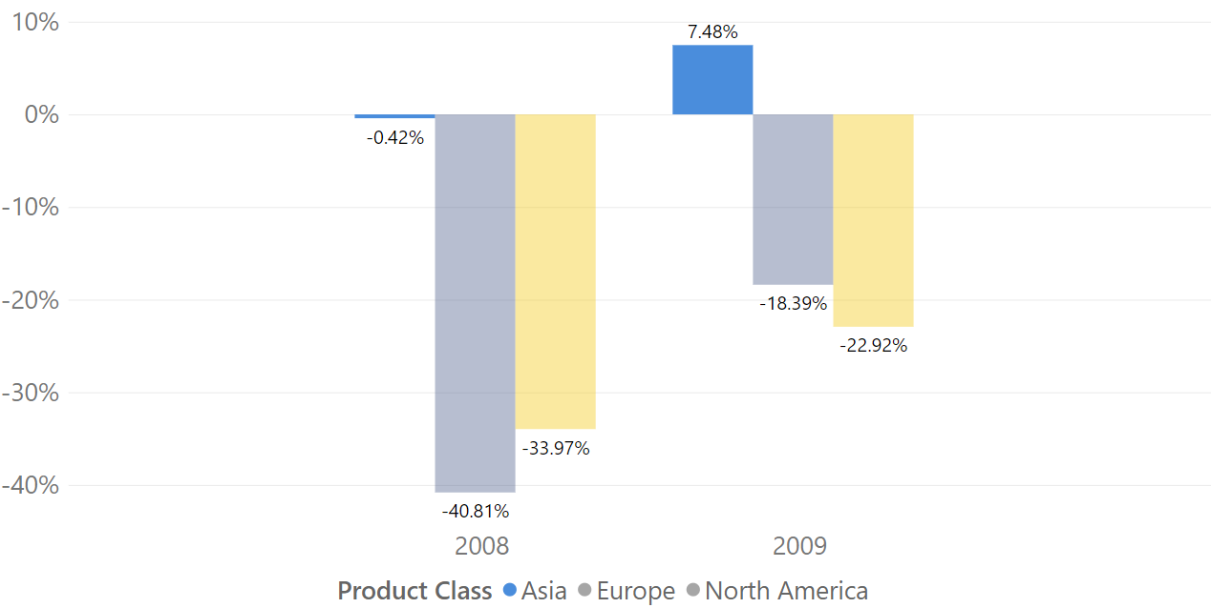
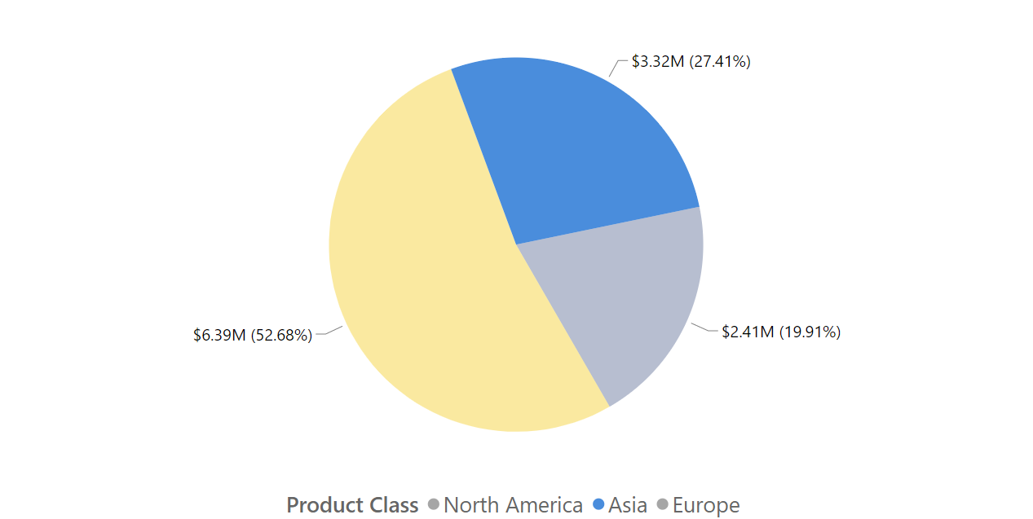
#1: Product Returns increases at Asia market
Return Quantity YoY% distribution by Continents
Return Amount distribution by Continents in 2009
Only the Asia market has a 7.48% rise in Return quantity in 2009, costing $3.32 million (Total return amount is ~$12 million).
We should pay more attention to figure out how Product Returns increase only in this market.

Slide 4
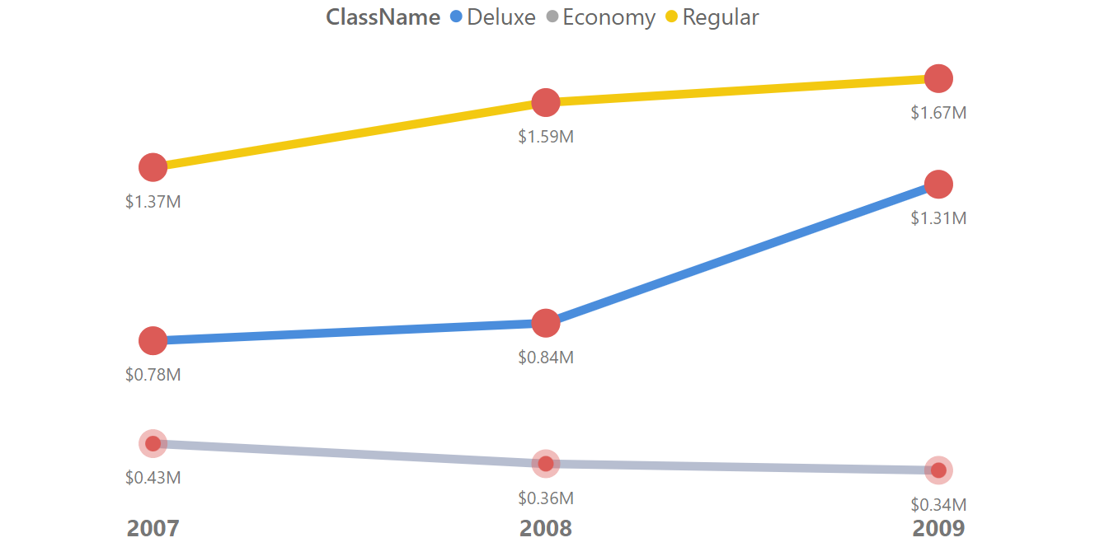
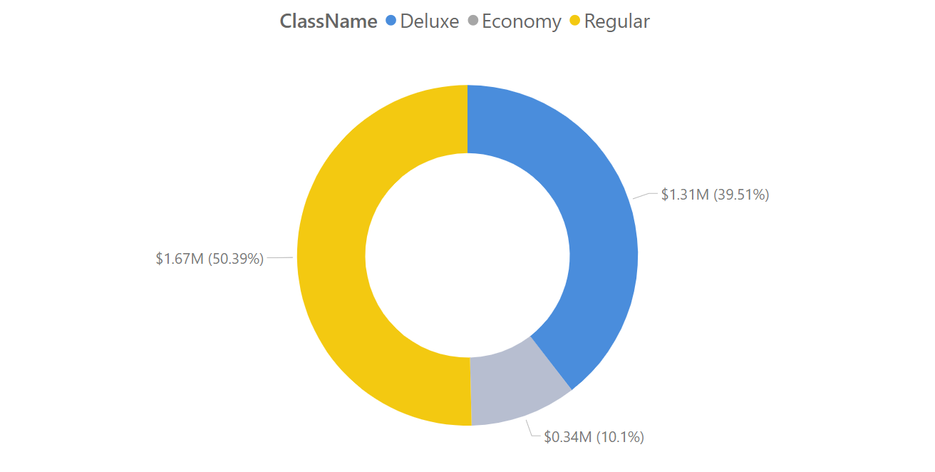
#2: Product Returns increases in Deluxe & Regular class at Asia market
Return Amount by Product Class at Asia market over time
Return Amount distribution by Product Class at Asia market in 2009
In Asia market, Deluxe & Regular class product shows an increase over time. In 2009, it accounts for ~90% of total Return amount.

Slide 5
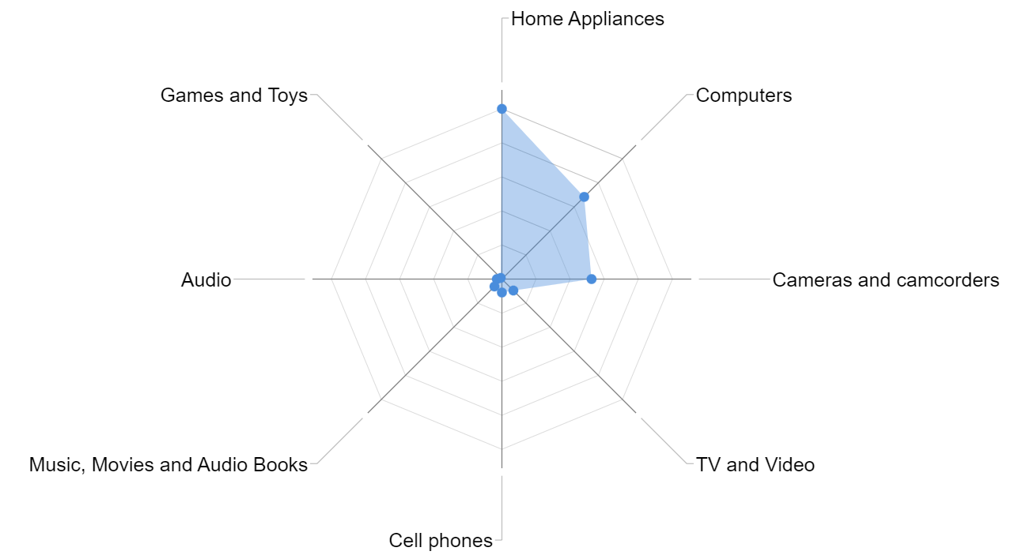
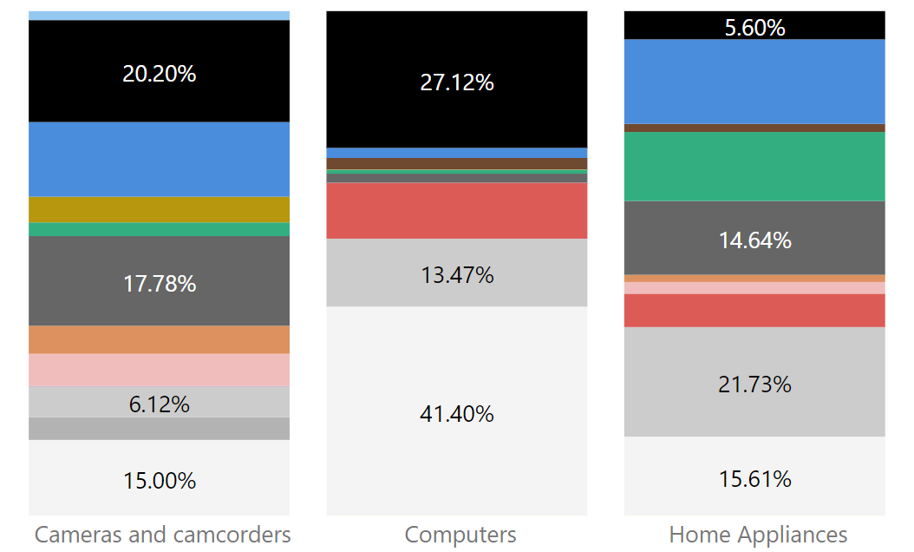
#3: Product Returns increases in Deluxe class at Asia market focus on …
Return Amount by Product Category (Deluxe class, Asia market)
Return Amount distribution by Color
(Deluxe class, Asia market)
Deluxe product class concentrates on electrical products in the Asian market, which include three categories: Home appliances, Computers, and Cameras & camcorders. The majority of the returned items are Monochrome in color (White, Silver, Silver Grey and Black).

Slide 6
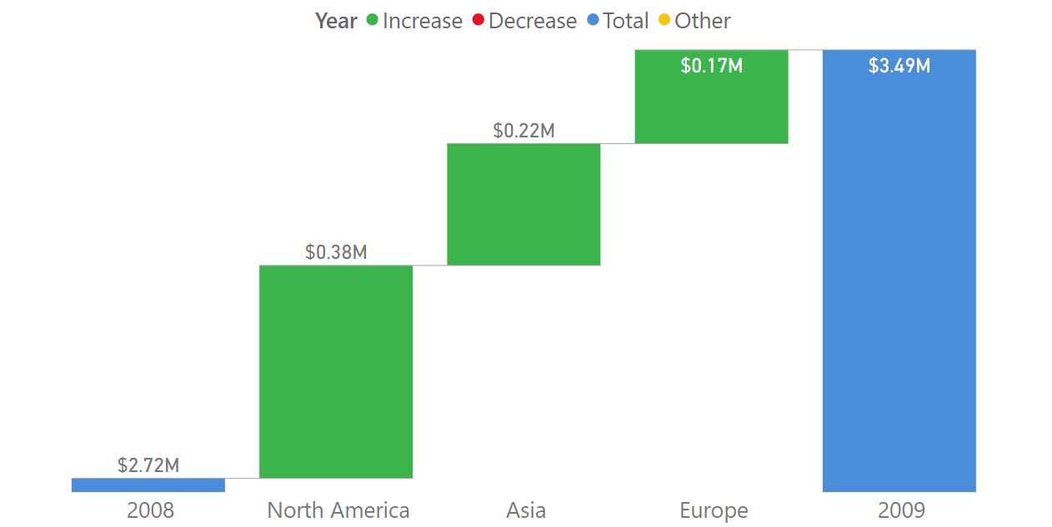
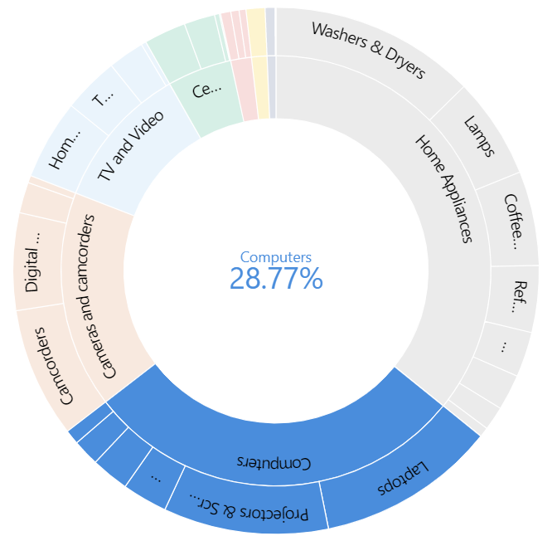
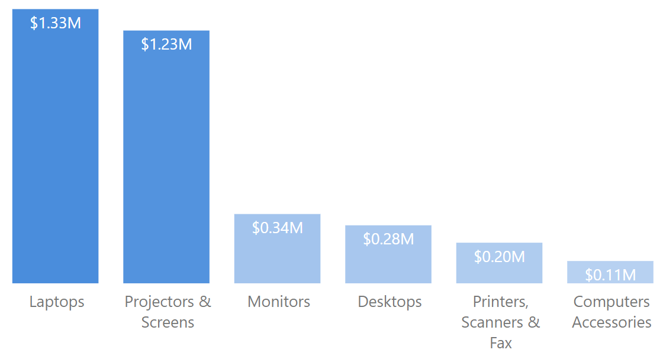
#4: Increase trend in Computer category across all markets for Returns
73.48%
Return Amount distribution in Computer Category
Return Amount of Computer in all markets
From 2008 to 2009, the Computer sector increased returns across the board. In 2009, it accounted for 28.77% of the overall Return amount. Laptops & Projectors and Screens contribute up to 73.48% of total distribution.

Slide 7
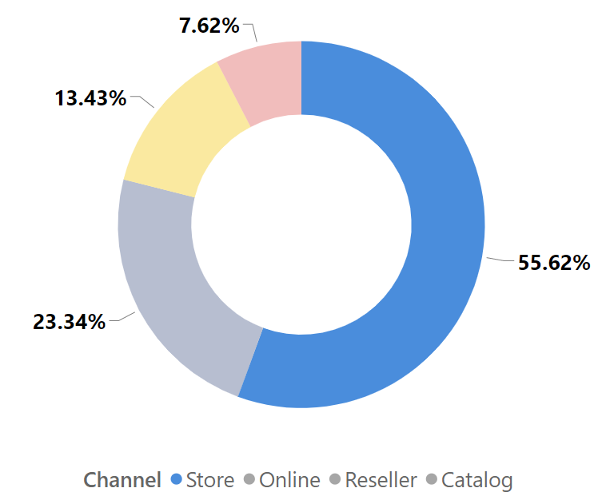
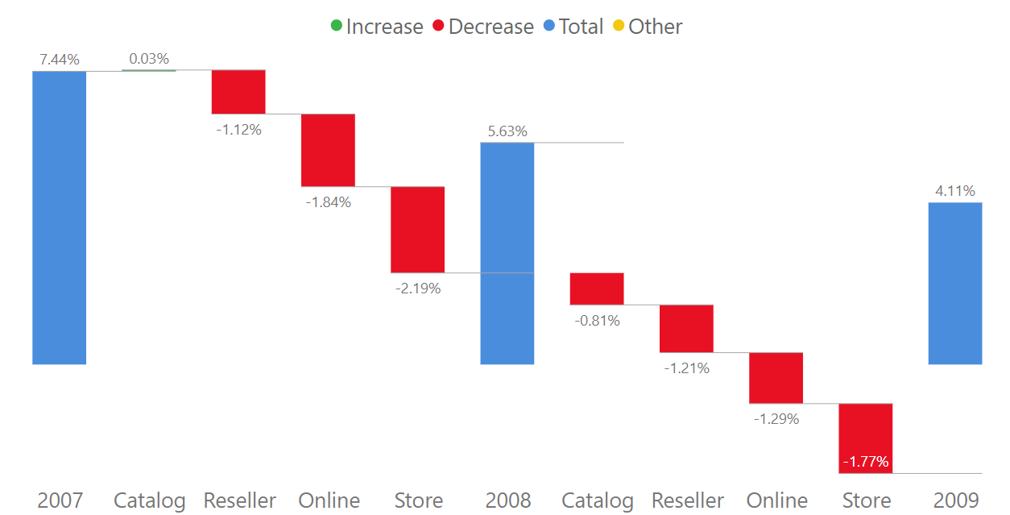
Return Rate % by different Channels
Return Rate % = (Return quantity / Sales quantity) %
Contribution of Store in Product Returns quantity
Return Rate % over time by different Channels
Store is one of the channels that provides about ~56% of Product Returns. Except for a little gain from the Catalog channel between 2007 and 2008 (0.03%), the majority of Return Rate % across all Channels decrease with time.

Slide 8
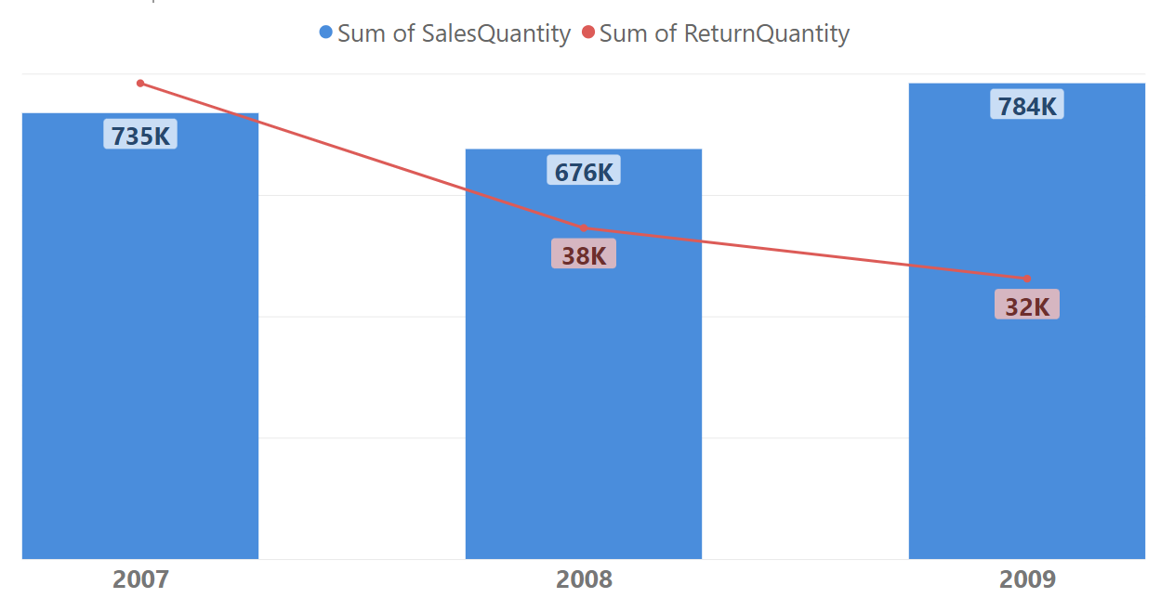
Return rate % decreased because of …
Return Rate % = (Return quantity / Sales quantity) %
Total Sales quantity and Total Return quantity over time
Due to a decline in Returns quantity and a rise in Sales quantity of selling products, the Return rate % has decreased.

Slide 9
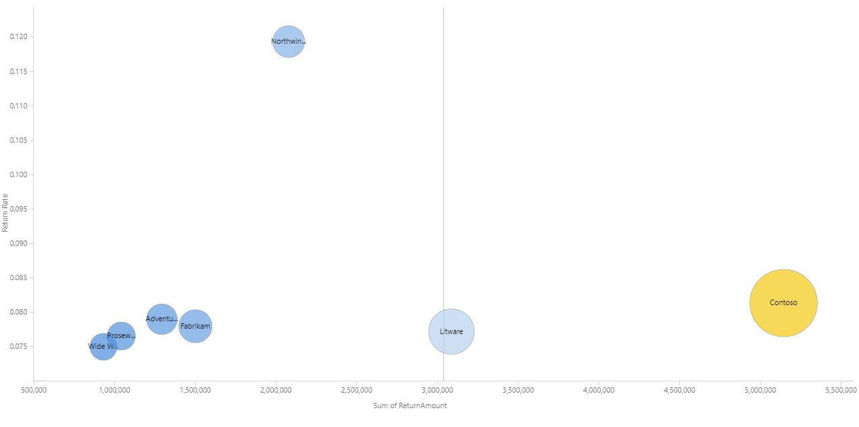
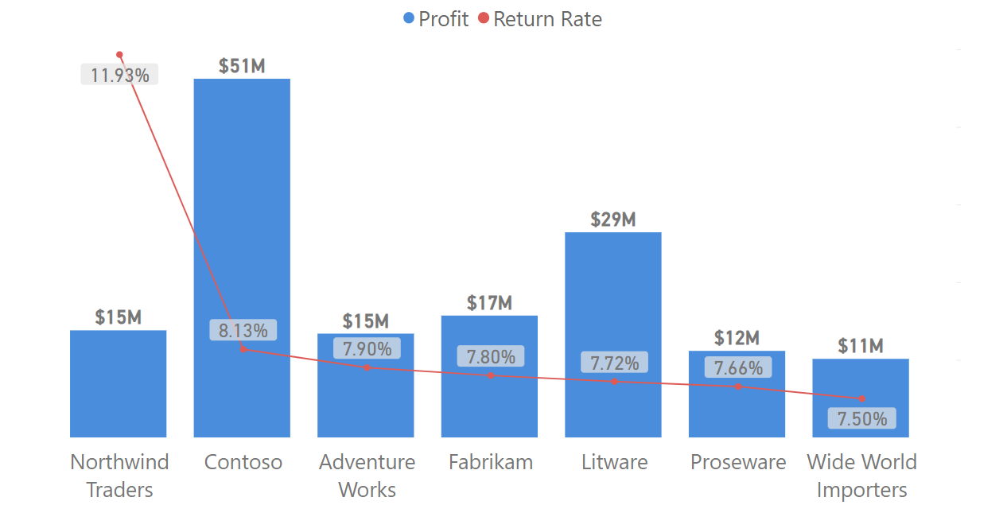
#5: Returns Rate % VS Profit …
Return Rate % = (Return quantity / Sales quantity) %
Northwind Traders
Return Rate % and Profit distribution by Brand (in Home Appliances category)
Northwind Traders brand has a significant Return rate of 11.93% in the Home Appliances sector (usually is about 6% to 8%), and the brand generates very little profit from its items.
Given that this brand makes little revenue and has a high return rate, we should consider importing Northwind Traders’ s products for Home appliances sales, it is not a potential investment

Slide 10
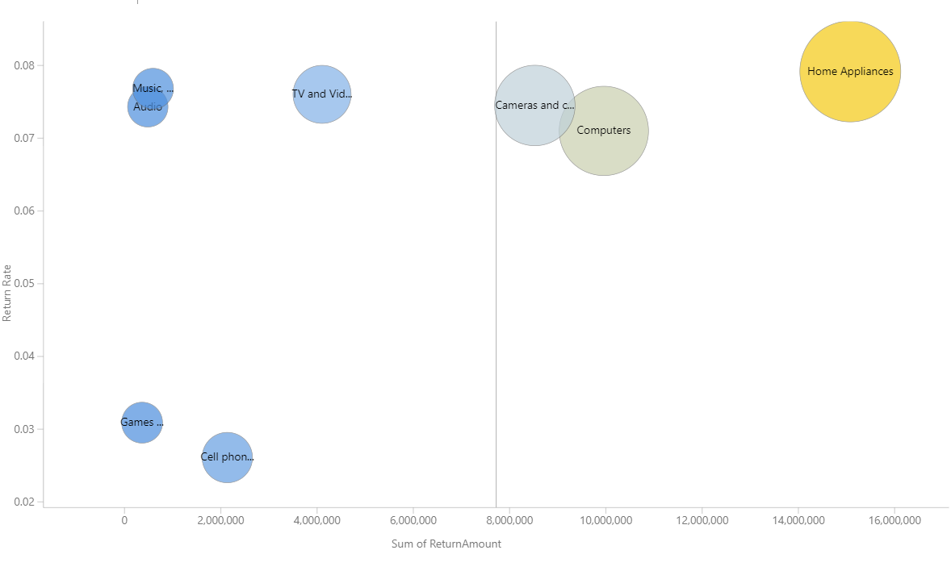
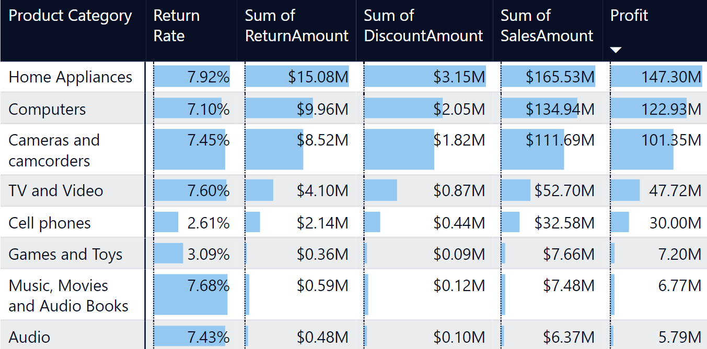
#5: Returns Rate % VS Profit …
Music, Movies and Audiobooks
Profit = Sale amount - Return amount - Discount amount
Audio
Return Rate % and Return Amount of all Product Categories (Bubble chart)
Music, Movies and Audio Books & Audio have high Return rate % and generate the least Profits for the company, which are $6.77 million and $5.79 million respectively.
We should consider more about two product categories: Music, Movies and Audio Books & Audio if they still have potential for investment.

Slide 11
#5: Returns Rate % VS Profit …
Profit = Sale amount - Return amount - Discount amount
Home Appliance
Return Rate % and Return Amount of all Product Categories (Bubble chart)
In addition to having the largest Total Return amount (~$15 million), the Home Appliances category also has the greatest Return volume per unit of sales compared to other categories - which indicating the highest Return rate (7.92%)
Due to its continued ability to generate enormous profits (~$147 million), this category still offers investment potential

Slide 12
AHA MOMENT
PRODUCT DISCOUNTS AFFECT TO THE REDUCE OF RETURN RATE %

Slide 13
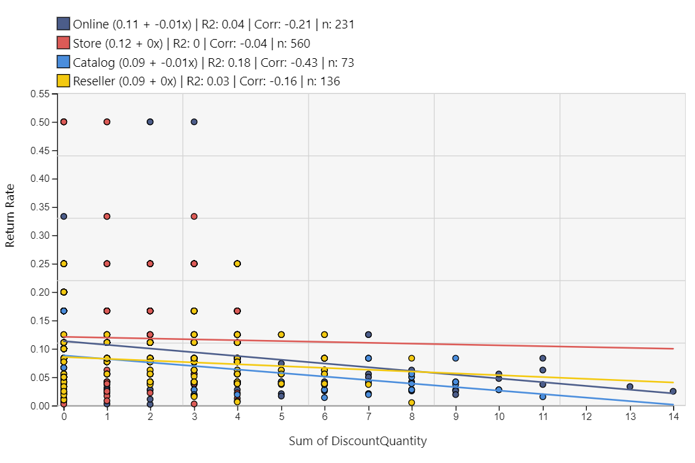
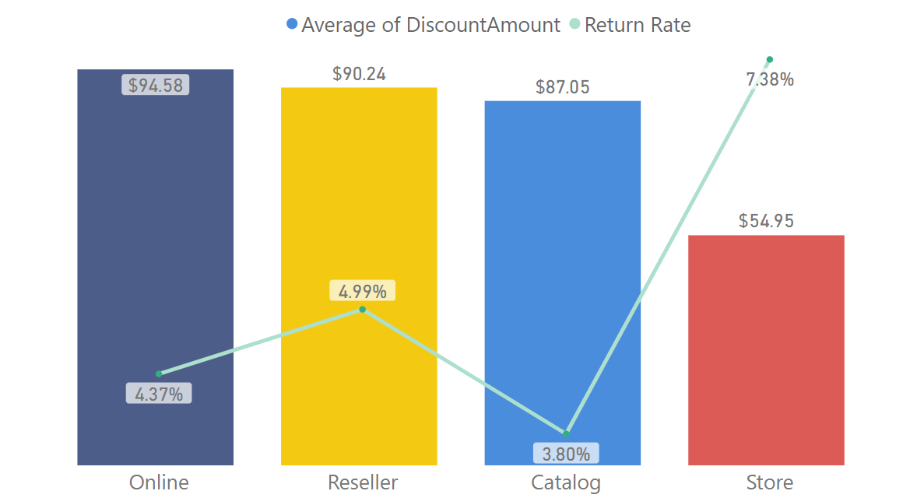
#6: Decline of Return Rate % by Discounts
Return Rate % and Discount quantity distribution per transaction
Average discount amount and Return rate % per transaction
When the Discount quantity is greater, the Return Rate% has reduced for each transaction.
Channels with lower Average discounts have highest Return rate %, especially Store, which has the highest Return rate 7.38 % and the lowest Average discount of $54.95 per transaction.

Slide 14
DATA STORY TEMPLATE
AHA MOMENT
HOOK & SETTING
01
02
Product discounts affect to the reduce of Return Rate %
There is a decrease of Return Rate % because of the decline in Return Quantity and increase in Sales quantity. (Setting)
Discounts is one of the factor that can make the Return Rate % decline, which is what the company target to (Hook)
03
RISING INSIGHTS
04
Focus on Product with high increase of Returns: Deluxe and Regular class in Asia market, especially in Computer
Return Rate % vs Profit: the contrast of Return Rate % and generated profit helps us to consider which product type and Brand to potentially invest in the future
Return Rate % vs Discounts: Discounts is a factor to help decline the Return Rate %
SOLUTION AND NEXT STEPS
Consider about the reason why specific Product types have high Return amount like Computer category
Consider about the investment of Brands and Product Category with least generated profit but high Return rate % like Music, Movies and Audiobooks and Audio
Supply Discounts to Customer to reduce Return Rate %

Slide 15
THANK YOU

